Slide 1

LAYOFF ANALYSIS
Presentation by – 20BAI10101 – Mahika Agrawal

Slide 2

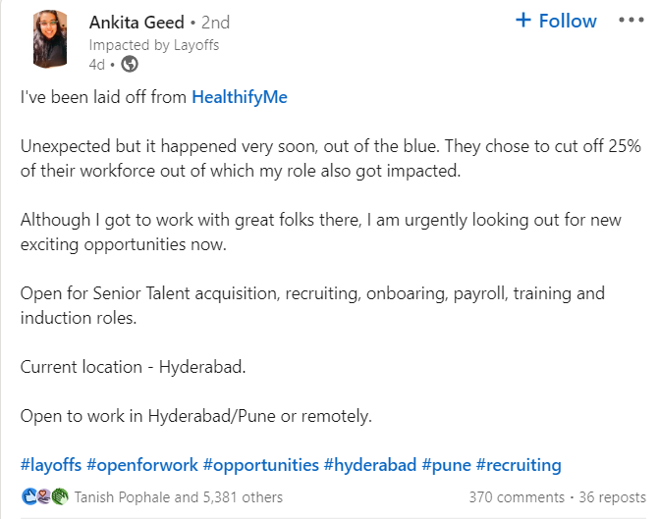
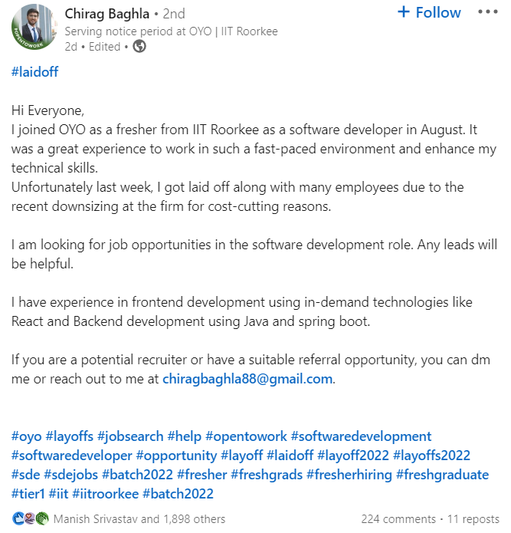




Slide 3

On the last slide, there were several examples of individuals who had just been laid off and were looking for job right away. I kept coming across postings on LinkedIn from individuals who had lost their jobs as a result of the recession. Employees who are suspended or laid off both experience some level of dread as a result of the layoff. Both suspended or dismissed workers and those who escape downsizing or staff layoffs may suffer grave consequences. Employees who have been laid off may display astonishment, rage, suspicion, skepticism, frustration, and escape. If employee layoffs are not handled carefully and correctly, there may be demonstrations and conflicts.
Link to the dataset : https://www.kaggle.com/datasets/swaptr/layoffs-2022
Link to Visualization :
https://public.tableau.com/app/profile/mahika.agrawal1593/viz/Layoff_2022_v01/CountryDashboard
https://public.tableau.com/app/profile/mahika.agrawal1593/viz/Layoff_2022_v02/Stageandfunds
https://public.tableau.com/app/profile/mahika.agrawal1593/viz/Layoff_2022_v03/YearlyDashboard

Slide 4
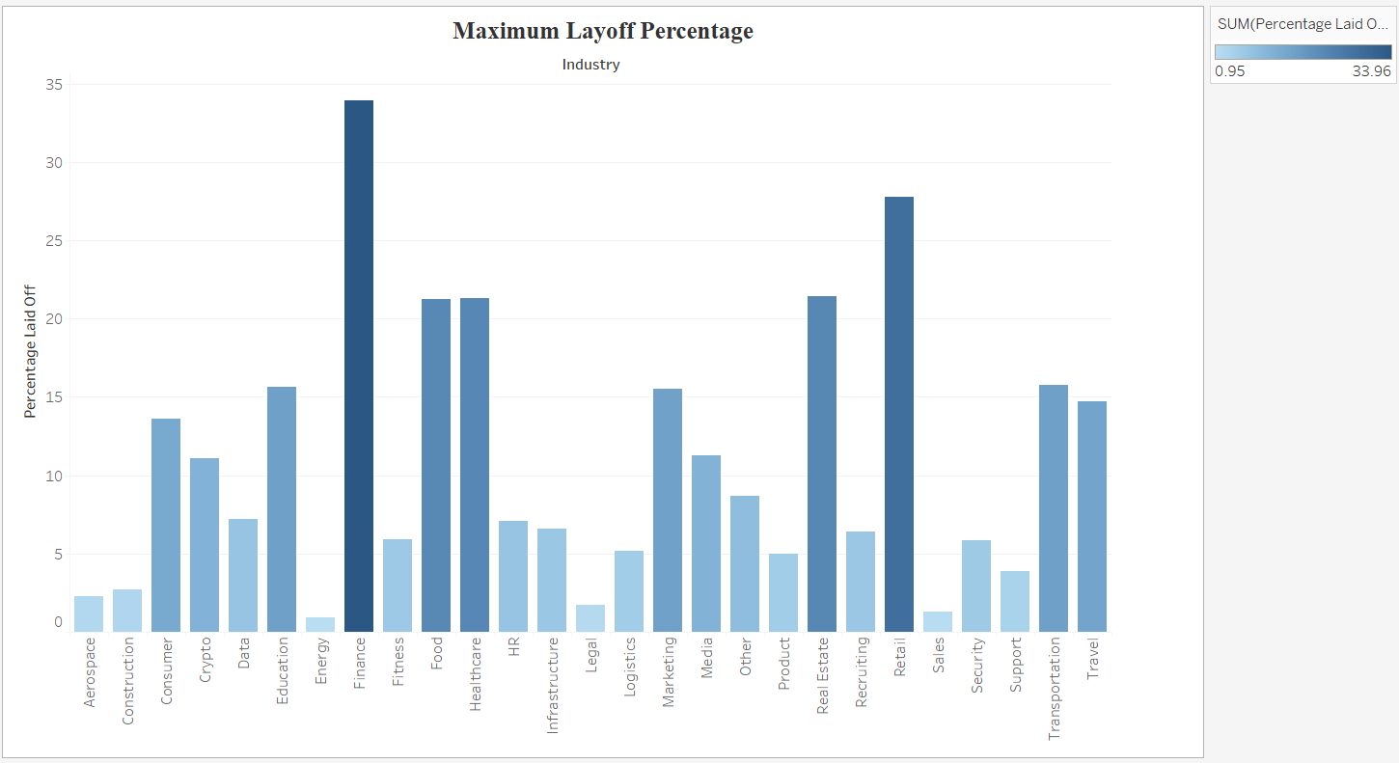
Industry-wise Layoff Percentage
Layoff anxiety is real, and it can significantly impact your well-being. Studies have shown that job insecurity can negatively impact your concentration and motivation and lead to mental health issues, such as anxiety and depression. The following visualization on the screen shows the Industry wise trends in Layoffs.

Slide 5
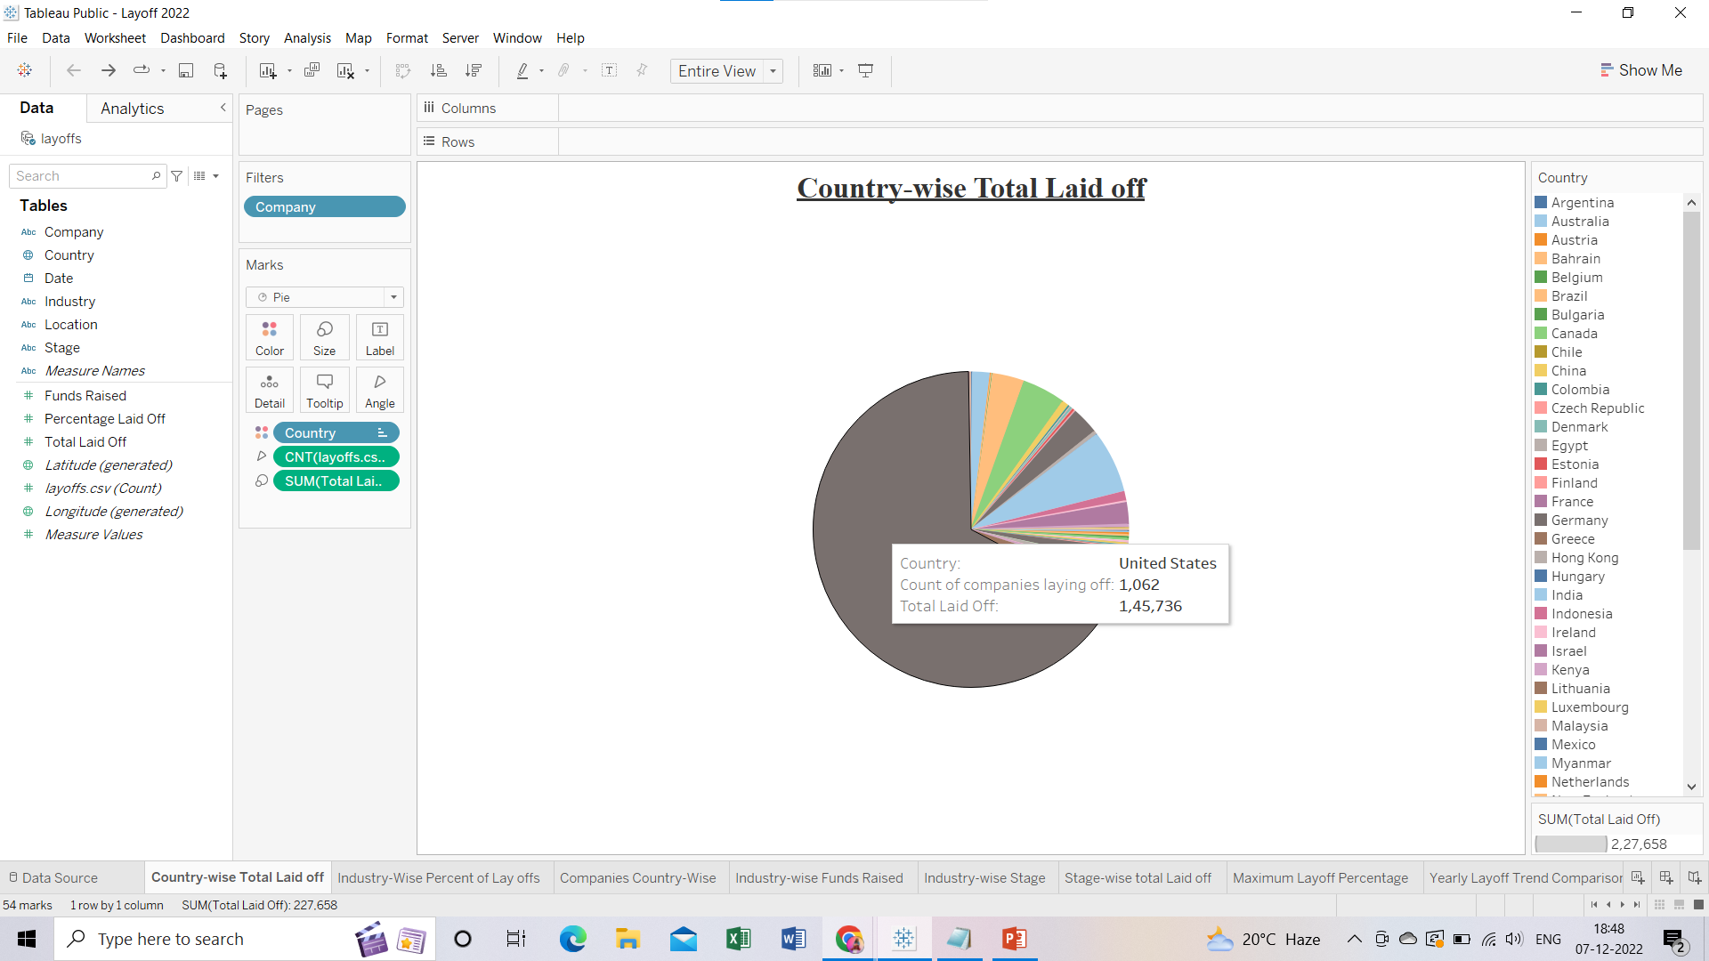
The pie chart shows that US has the maximum number of Layoffs. Around 1062 companies have laid off 1,45,736 employees and it still hasn’t stopped. Corporate America is drastically reducing its workforce as part of its restructuring efforts to prepare for a probable economic downturn brought on by the U.S. Federal Reserve's fight against inflation and the war in Ukraine
Country-wise Total Laid off

Slide 6
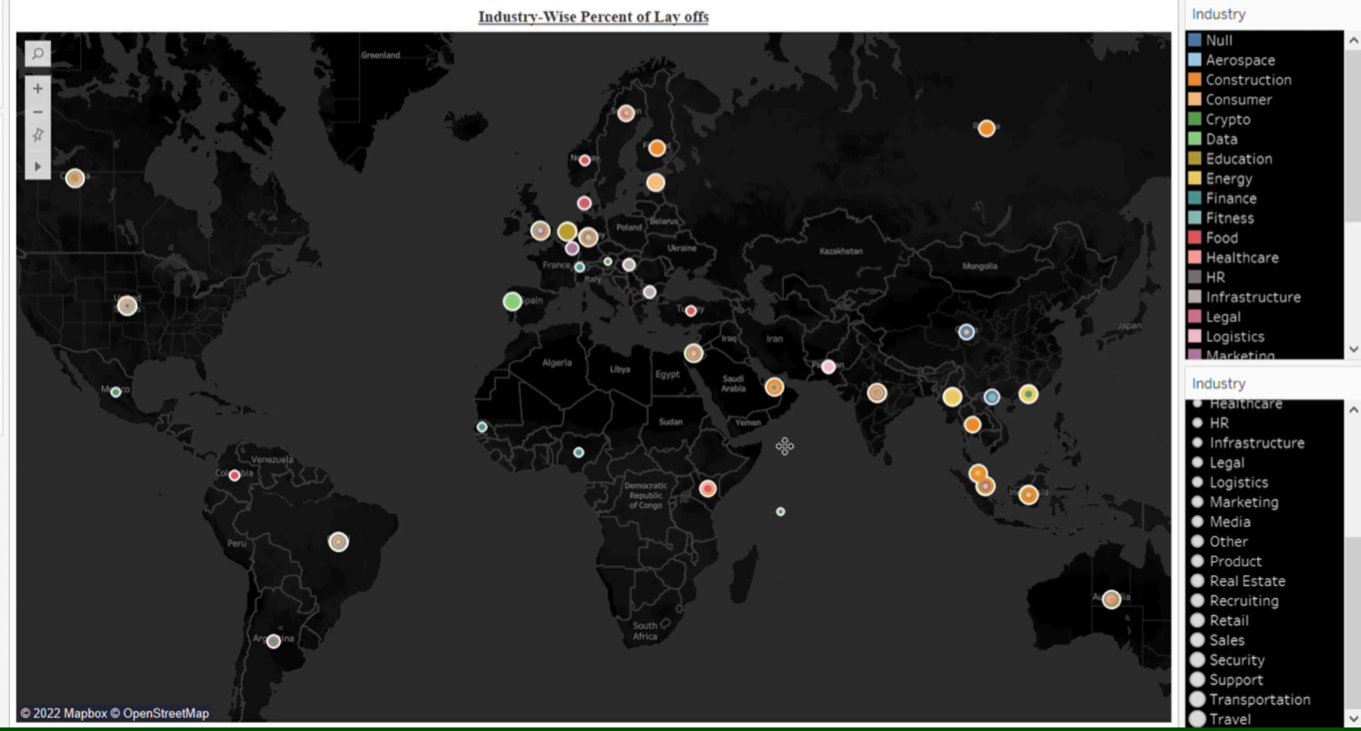
The following map shows the percentage of layoff of each industry in each country
Industry wise Layoff Percentage

Slide 7
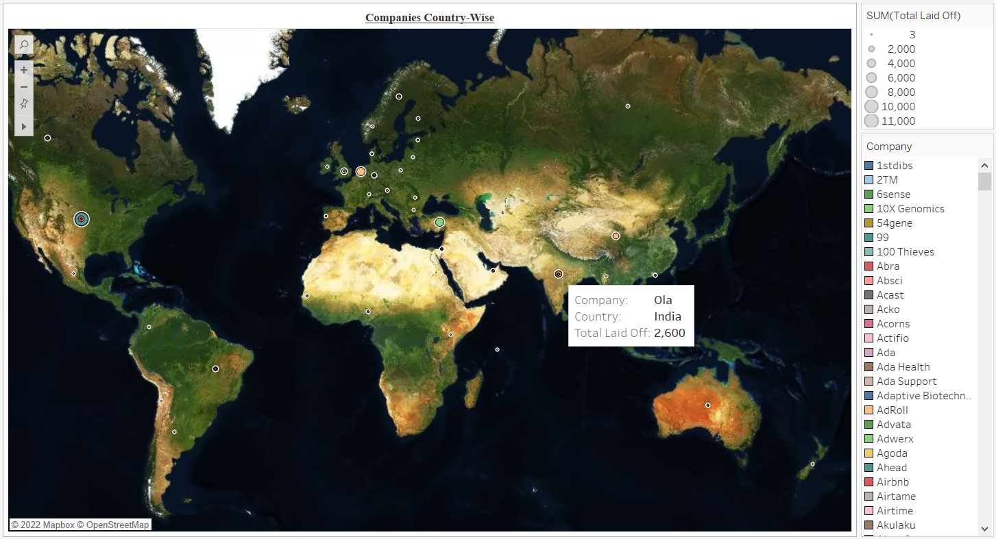
Companies Country-wise
Location plays a huge role in attracting and retaining the best employees, many of whom keep a close eye on where they're based in order to optimize work-life balance. Good location decisions can significantly boost a company's long-term performance. Poor ones can cost millions in lost talent, productivity and capital.

Slide 8
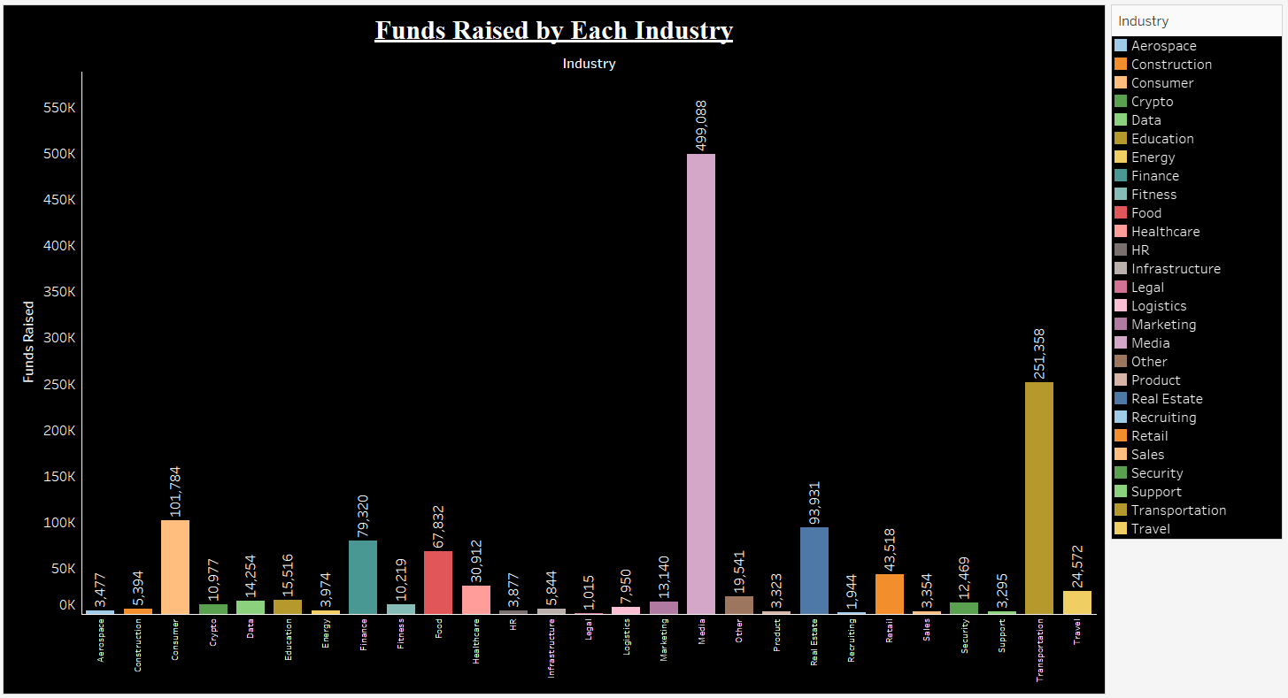
Funds Raised by each Industry
The main sources of funding are retained earnings, debt capital, and equity capital. Companies use retained earnings from business operations to expand or distribute dividends to their shareholders. Businesses raise funds by borrowing debt privately from a bank or by going public (issuing debt securities). The following bar graph shows that the maximum amount of funds have been raised by the Media industry

Slide 9
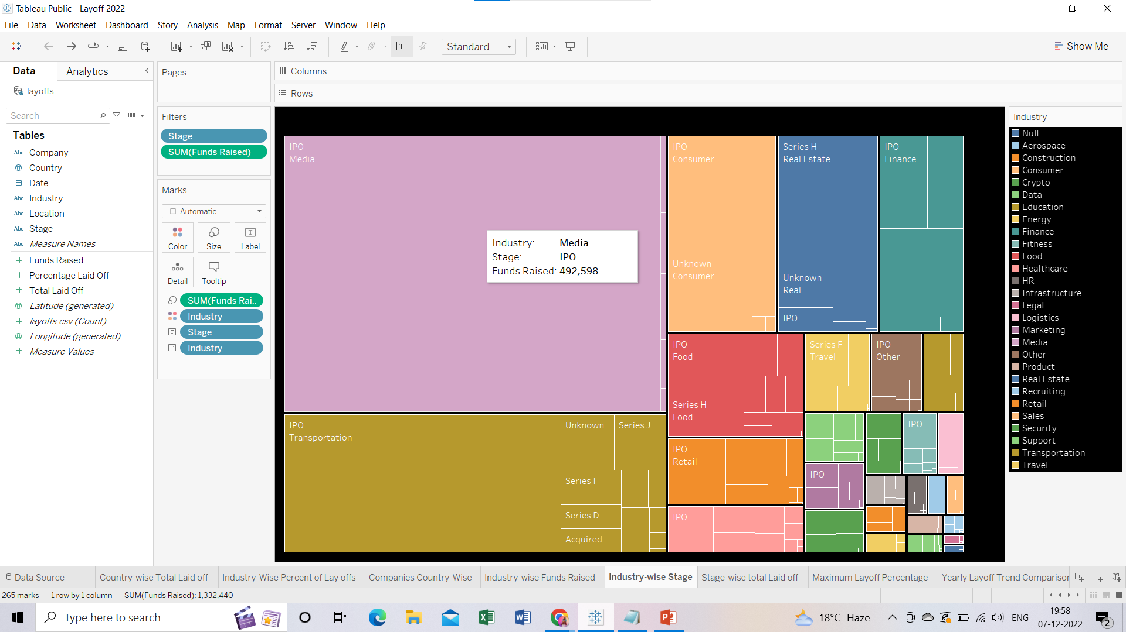
The following Tree Map shows the Industry, Stage and their respective funds raised.

Slide 10
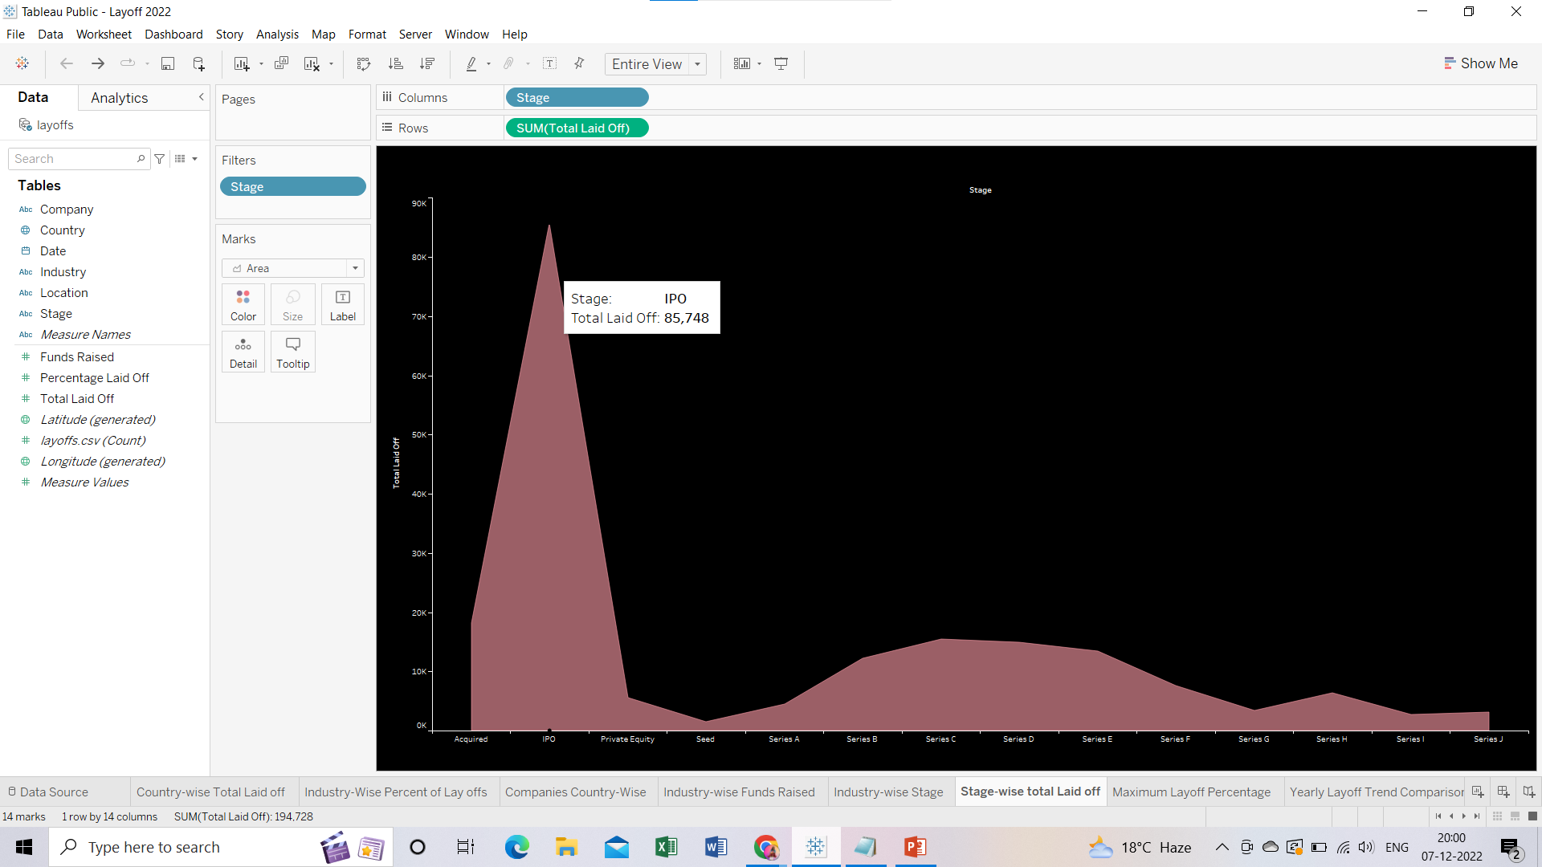
This bar graph shows the total number of people who had been laid off belonging to a particular stage

Slide 11
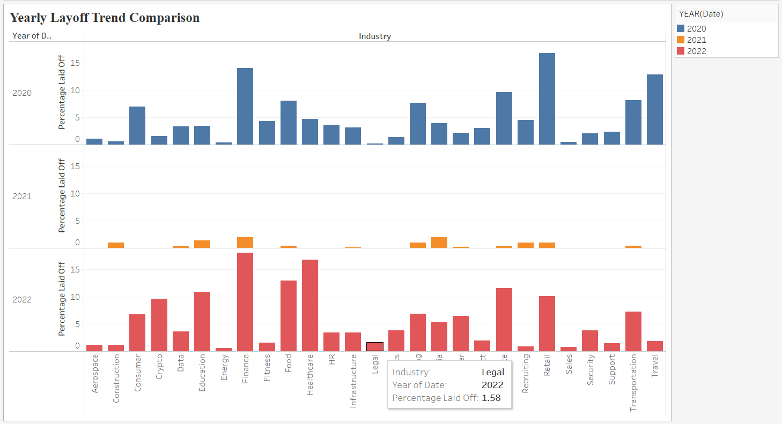
Yearly Layoff Trend Comparison
The bar graph shows the year wise trends in lay offs in each industry. From the bar graph we can derive that 2022 has gone through the maximum number of layoffs irrespective of the industry

Slide 12
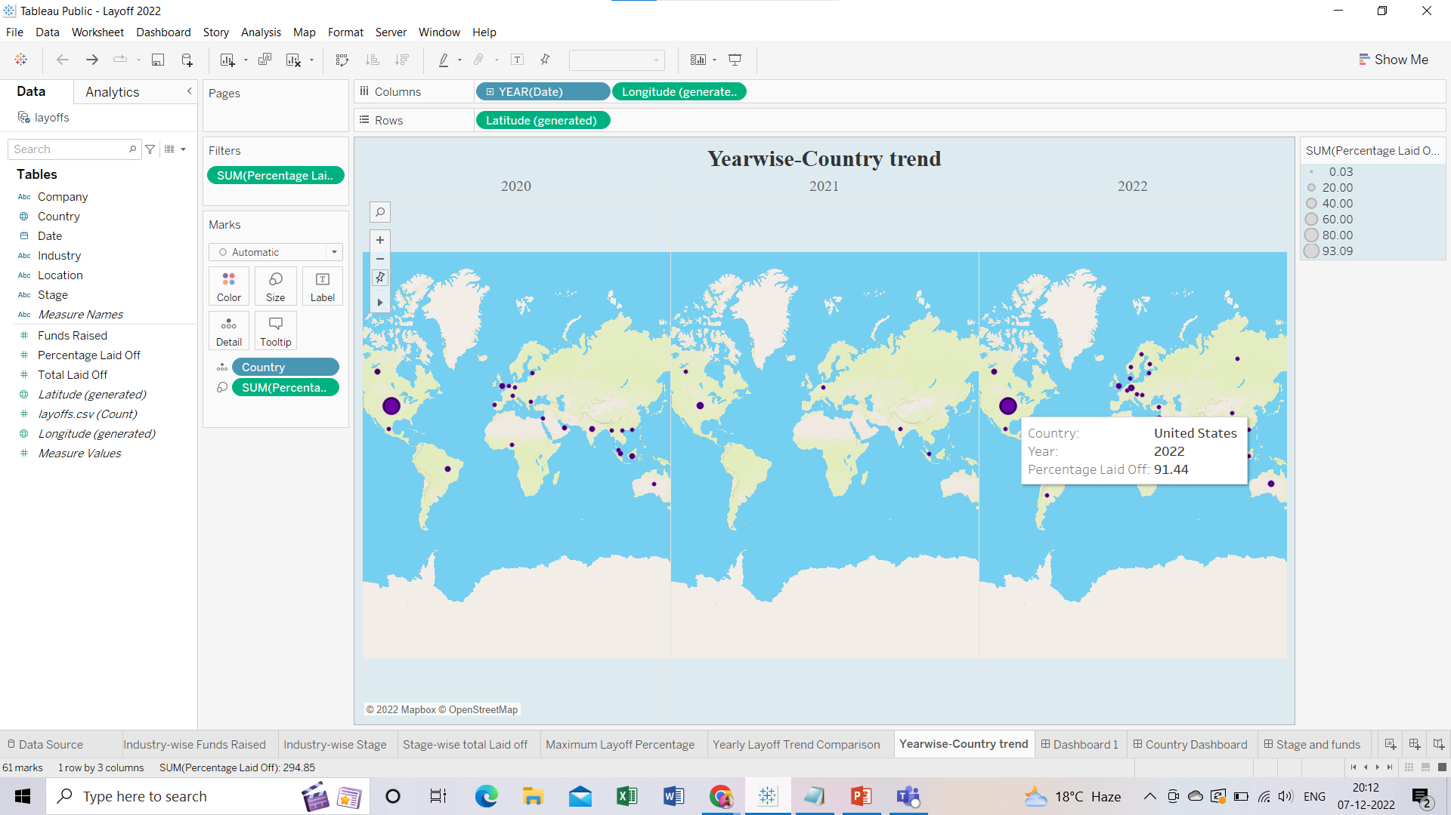
Year wise Country Trend This map is the year wise trend of Companies and their respective lay-off percentage over the course of 3 years from 2020 to 2022

Slide 13
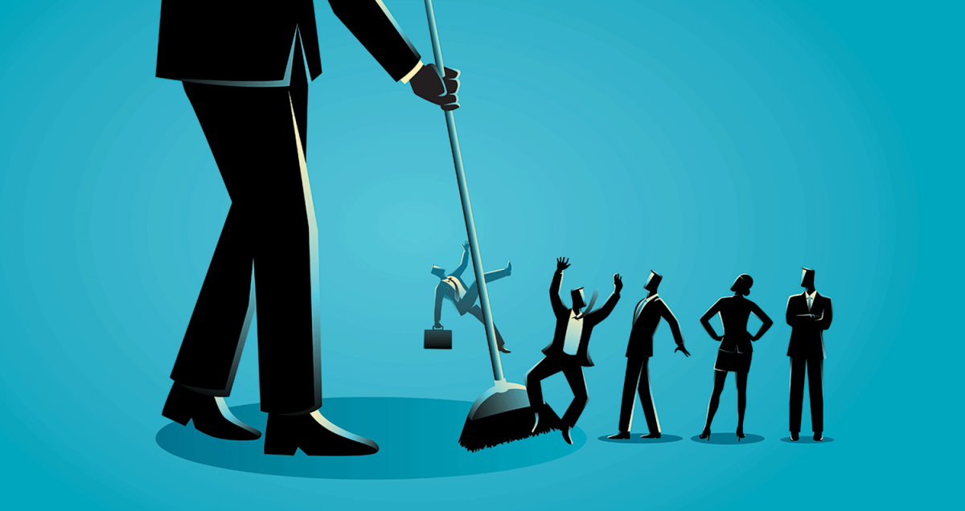
The most common reasons why employees are laid off include cost-cutting, staff reduction, relocation, buyouts, and mergers. However, company owners can choose other options instead of terminating their employees' contracts. The person who is laid off suffers the most distress, but remaining employees suffer emotionally as well. Lets be nice to each other and make this world a better place to live and thrive.

